Slide 1
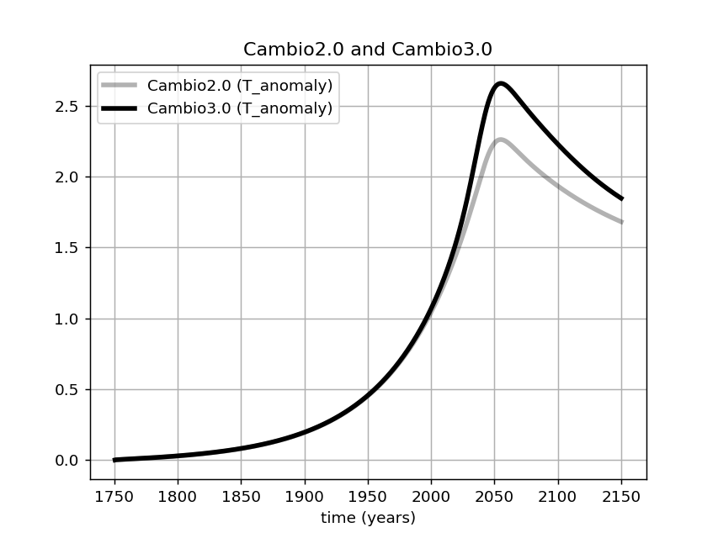
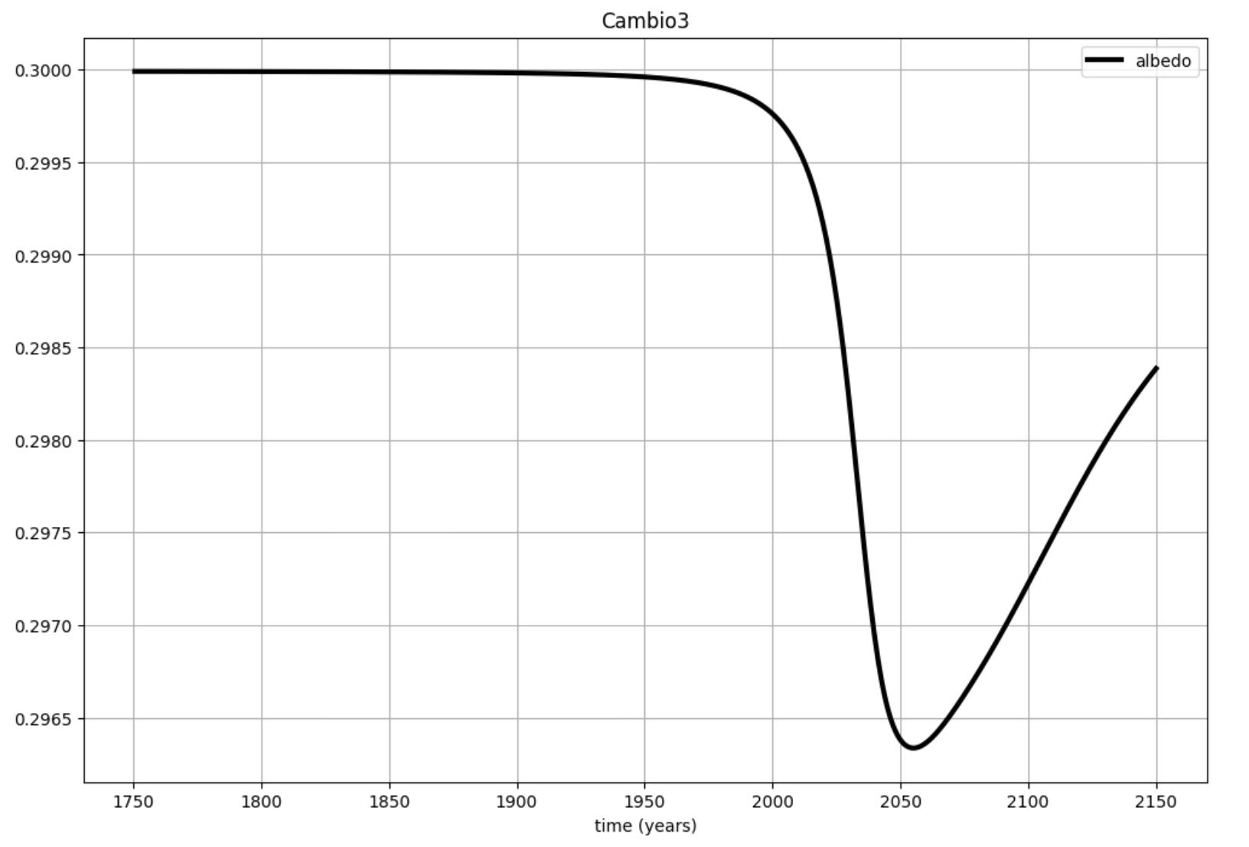
Lessons from Cambio 3.0: lowered albedo bumps up warming by about 0.4 $℃$
Cambio 2.0 (fixed albedo)
Cambio 3.0
(w/ice-albedo feedback)

Slide 2
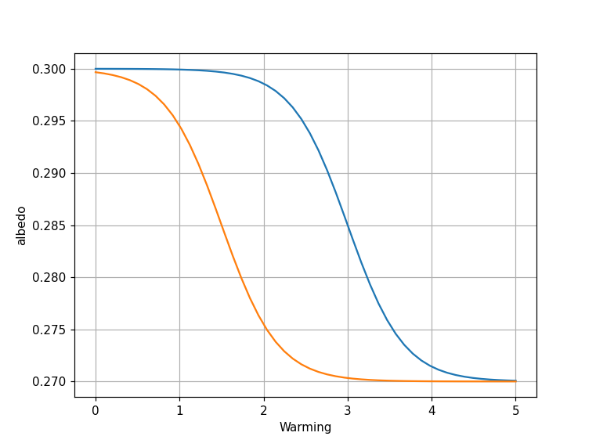
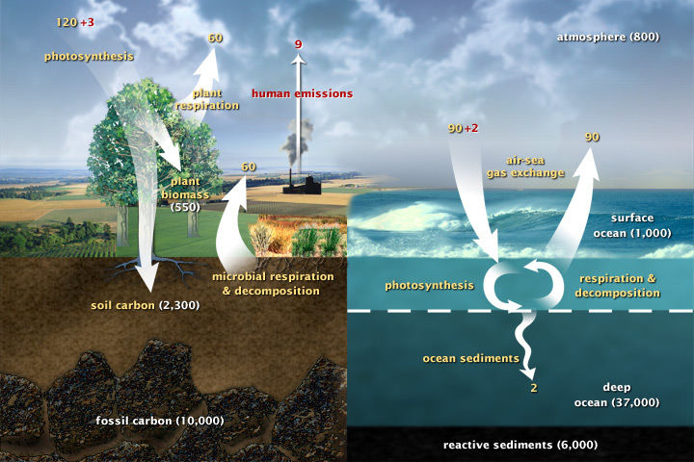


Another project idea: What if the albedo tipping point happens at a lower temperature?
$T_{albedo}^{∗}=3$ degrees
$$T_{albedo}^{∗}=1.5$$

